Slide 1
Using NetworkX for Pathfinding
Max Bezahler
August 15,2015
PyGotham NYC

Slide 2
Objectives at a Glance
At the end of this 25min session you will be able to
Go to a web based simulation to see general concepts
Have recommendations for setting python and networkx, ipython and an IDE
create example networkx graphs
create specific example graphs with layouts
Describe Dijkstra’s algorithm from pseudo code to implementation
test python implementation of Dijksta in IPython
Describe A* from pseudo code to implementation
Test implementation of A* in IPython
Introduction Theta*, Phi* and Ant Colony Optimization (ACO)

Slide 3
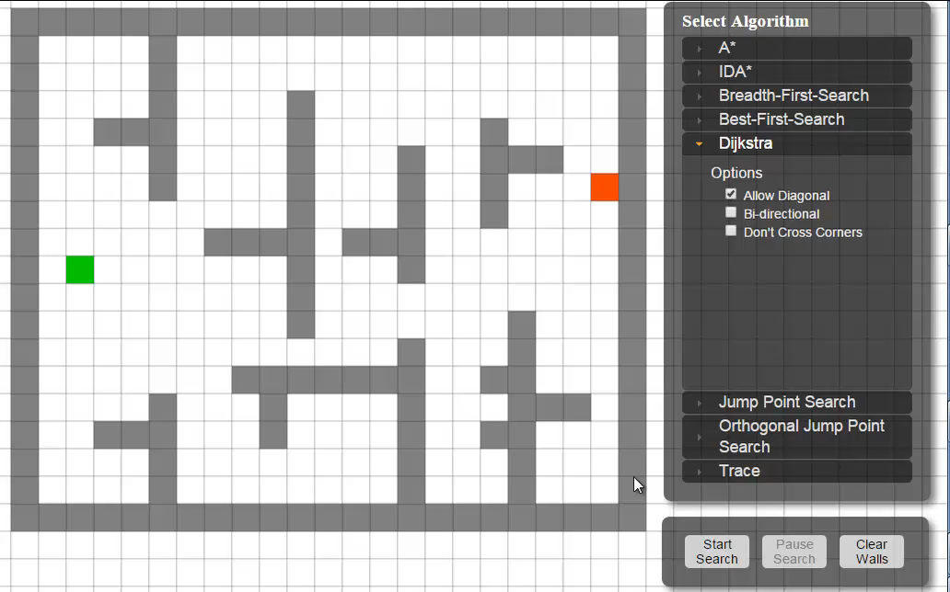
Quick examples
http://qiao.github.io/PathFinding.js/visual/

Slide 4
Setup
Keep it very simple
Anaconda very simple to use and free can use Spyder or another IDE
Enthought Canopy also free and comes with many modules as well as
Pyscripter IDE (must match version of python installed 32bit)
Eclipse is also free and more functionality (requires Java, requires pydev )
Optional
Download Gephi – very good for large visualizations
Excel users can use NodeXL, good for quick modeling
Go to Notebook 1 for examples and intro to using api

Slide 5
What’s a Path, What’s Graph? What’s NetworkX?
Wikipedia to the rescue!
Pathfinding – “shortest route between two points”
Graph Theory – “which are mathematical structures used to model pairwise relations between objects. A "graph" in this context is made up of “vertices" or "nodes" and lines called edges that connect them”
Graph G = (V,E) ordered pair of vertices and edges where edges are abbreviated {u,v} or uv
NetworkX – site and documentation
“NetworkX is a Python language software package for the creation, manipulation, and study of the structure, dynamics, and function of complex networks.
With NetworkX you can load and store networks in standard and nonstandard data formats, generate many types of random and classic networks, analyze network structure, build network models, design new network algorithms, draw networks, and much more.”
The shortest path to knowledge about shortest path algorithms is: http://www.redblobgames.com/ by Amit Patel.
Go to Notebook 1 for examples and intro to using api

Slide 6
Creating Graphs in networkx
Go to Notebook 2 for examples and hands on
nx.draw(g1)
nx.draw_networkx(G, pos=None, with_labels=True, **kwds) – but a long list of options!
nx.draw_networkx_edges(G, pos, edgelist=None, width=1.0, edge_color='k', style='solid', alpha=None,edge_cmap=None, edge_vmin=None, edge_vmax=None, ax=None, arrows=True, label=None, **kwds)
nx.draw_networkx_labels(G, pos, labels=None, font_size=12, font_color='k', font_family='sans-serif',font_weight='normal', alpha=1.0, ax=None, **kwds)
nx.draw_node_labels(G, pos, labels=None, font_size=12, font_color='k', font_family='sans-serif',font_weight='normal', alpha=1.0, ax=None, **kwds)
spring_layout(G, dim=2, k=None, pos=None, fixed=None, iterations=50, weight='weight', scale=1.0)
draw_spectral - no pos value

Slide 7
Dijkstra
Psuedo Code
Dijkstra
Dijkstra Algorithm: Short terms and Pseudocode
Using the Dijkstra algorithm, it is possible to determine the shortest distance (or the least effort / lowest cost) between a start node and any other node in a graph. The idea of the algorithm is to continiously calculate the shortest distance beginning from a starting point, and to exclude longer distances when making an update. It consists of the following steps:
Initialization of all nodes with distance "infinite"; initialization of the starting node with 0
Marking of the distance of the starting node as permanent, all other distances as temporarily.
Setting of starting node as active.
Calculation of the temporary distances of all neighbour nodes of the active node by summing up its distance with the weights of the edges.
If such a calculated distance of a node is smaller as the current one, update the distance and set the current node as antecessor. This step is also called update and is Dijkstra's central idea.
Setting of the node with the minimal temporary distance as active. Mark its distance as permanent.
Repeating of steps 4 to 7 until there aren't any nodes left with a permanent distance, which neighbours still have temporary distances.
1: | function Dijkstra(Graph, source): | //
2: | for each vertex v in Graph: | // Initialization
3: | dist[v] := infinity | // initial distance from source to vertex v is set to infinite
4: | previous[v] := undefined | // Previous node in optimal path from source
5: | dist[source] := 0 | // Distance from source to source
6: | Q := the set of all nodes in Graph | // all nodes in the graph are unoptimized - thus are in Q
7: | while Q is not empty: | // main loop
8: | u := node in Q with smallest dist[ ]
9: | remove u from Q
10: | for each neighbor v of u: | // where v has not yet been removed from Q.
11: | alt := dist[u] + dist_between(u, v)
12: | if alt < dist[v] | // Relax (u,v)
13: | dist[v] := alt
14: | previous[v] := u
15: | return previous[ ]
Simulation

Slide 8


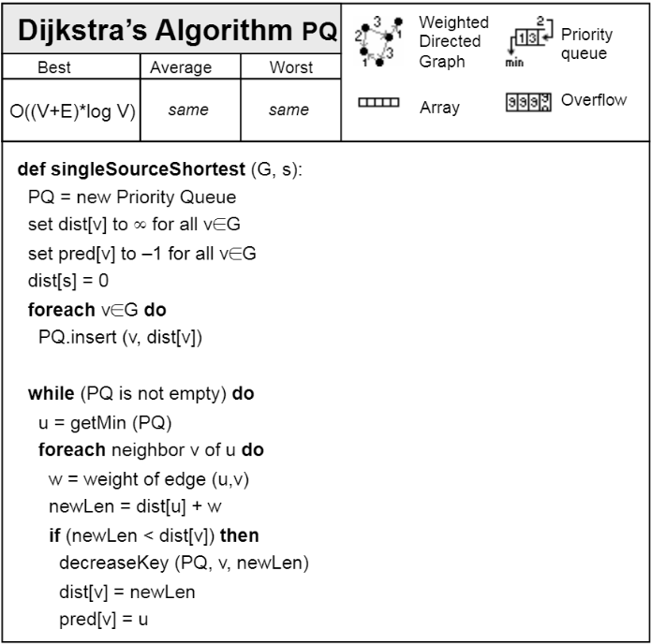
Dijkstra via George Heineman
Python Algorithms
Heineman Python Code https://github.com/heineman/python-algorithms
while not pq.isEmpty():
u = pq.smallest()
for v in graph[u]:
wt = graph[u][v]
newLen = dist[u] + wt
if newLen < dist[v]:
pq.decreaseKey(v, newLen)
dist[v] = newLen
pred[v] = u
return (dist, pred)

Slide 9
Djikstra
g2
{0: {1: 1, 2: 4},
1: {2: 2, 3: 5, 4: 12},
2: {3: 2}, 3: {4: 3},
4: {}}
dist
{0: 0, 1: 2147483647, 2: 2147483647, 3: 2147483647, 4: 2147483647}
pred
{0: None, 1: None, 2: None, 3: None, 4: None}
print (pq.elements)
[[0, None], [0, 0], [2147483647, 4], [2147483647, 2], [2147483647, 1], [2147483647, 3]]
1
12
1
5
S
2
3
4
0
3
4
2
2
From node 0 check 1 graph g2:
{0: {1: 1, 2: 4}, 1: {2: 2, 3: 5, 4: 12}, 2: {3: 2}, 3: {4: 3}, 4: {}}
dist
{0: 0, 1: 1, 2: 2147483647, 3: 2147483647, 4: 2147483647}
print pq.elements
[[0, None], [1, 1], [2147483647, 3], [2147483647, 2], [2147483647, 4], [2147483647, 3]]
dist
{0: 0, 1: 1, 2: 2147483647, 3: 2147483647, 4: 2147483647}
pred
{0: None, 1: 0, 2: None, 3: None, 4: None}
while not pq.isEmpty():
u = pq.smallest()
for v in graph[u]:
wt = graph[u][v]
newLen = dist[u] + wt
if newLen < dist[v]:
pq.decreaseKey(v, newLen)
dist[v] = newLen
pred[v] = u
return (dist, pred)
From node 0 check node 2
{0: {1: 1, 2: 4}, 1: {2: 2, 3: 5, 4: 12}, 2: {3: 2}, 3: {4: 3}, 4: {}}
[g2[u]
{1: 1, 2: 4}
dist
{0: 0, 1: 1, 2: 4, 3: 2147483647, 4: 2147483647}
print pq.elements
[[0, None], [1, 1], [2147483647, 3], [4, 2], [2147483647, 4], [2147483647, 3]]
pred
{0: None, 1: 0, 2: 0, 3: None, 4: None}
Done! Check pq and pull next lowest distance and node

Slide 10
Djikstra
g2
{0: {1: 1, 2: 4},
1: {2: 2, 3: 5, 4: 12},
2: {3: 2}, 3: {4: 3},
4: {}}
dist
{0: 0, 1: 2147483647, 2: 2147483647, 3: 2147483647, 4: 2147483647}
pred
{0: None, 1: None, 2: None, 3: None, 4: None}
print (pq.elements)
[[0, None], [0, 0], [2147483647, 4], [2147483647, 2], [2147483647, 1], [2147483647, 3]]
1
12
1
5
S
2
3
4
0
3
4
2
2
Node 1
pq.elements
[[0, None], [1, 1], [2147483647, 3], [4, 2], [2147483647, 4], [2147483647, 3]]
g2[1] #nodes 2,3,4
{2: 2, 3: 5, 4: 12}
dist # node 1 and 2 looked at 3 and 4 at maxsize
{0: 0, 1: 1, 2: 4, 3: 2147483647, 4: 2147483647}
print pq.elements #node 2 changed to 3
[[0, None], [3, 2], [2147483647, 3], [2147483647, 4], [2147483647, 4], [2147483647, 3]]
print pq.elements #node 3 put in as 6
[[0, None], [3, 2], [6, 3], [2147483647, 4], [2147483647, 4], [2147483647, 3]]
dist
{0: 0, 1: 1, 2: 3, 3: 6, 4: 2147483647}
pred
{0: None, 1: 0, 2: 1, 3: 1, 4: None}
Node 4
pq.elements
[[0, None], [3, 2], [6, 3], [13, 4], [2147483647, 4], [2147483647, 3]]
dist
{0: 0, 1: 1, 2: 3, 3: 6, 4: 13}
pred
{0: None, 1: 0, 2: 1, 3: 1, 4: 1}
while not pq.isEmpty():
u = pq.smallest()
for v in graph[u]:
wt = graph[u][v]
newLen = dist[u] + wt
if newLen < dist[v]:
pq.decreaseKey(v, newLen)
dist[v] = newLen
pred[v] = u
return (dist, pred)

Slide 11
Djikstra
1
12
1
g2
{0: {1: 1, 2: 4},
1: {2: 2, 3: 5, 4: 12},
2: {3: 2},
3: {4: 3},
4:: {} }
5
S
2
3
4
0
3
4
2
2
Node 2 is next because lowest distance in priority queue with dist of 3
print pq.elements #prior to smallest
[[0, None], [3, 2], [6, 3], [13, 4], [2147483647, 4], [2147483647, 3]]
pq.elements #after smallest – on node #2
[[0, None], [6, 3], [13, 4], [13, 4], [2147483647, 4], [2147483647, 3]]
dist #node 3 is 6units away
{0: 0, 1: 1, 2: 3, 3: 6, 4: 13}
newLen will be 3+2= 5 < dist[v]
pq.elements #before decrease
[[0, None], [6, 3], [13, 4], [13, 4], [2147483647, 4], [2147483647, 3]]
pq.elements #after
[[0, None], [5, 3], [13, 4], [13, 4], [2147483647, 4], [2147483647, 3]]
dist #new
{0: 0, 1: 1, 2: 3, 3: 5, 4: 13}
pred #new
{0: None, 1: 0, 2: 1, 3: 2, 4: 1}
while not pq.isEmpty():
u = pq.smallest()
for v in graph[u]:
wt = graph[u][v]
newLen = dist[u] + wt
if newLen < dist[v]:
pq.decreaseKey(v, newLen)
dist[v] = newLen
pred[v] = u
return (dist, pred)
Go to Notebook 3 for examples and hands on

Slide 12
From Dijkstra to A*
Need an improved Dijkstra by putting in a guess (heuristic) to h.
H or heuristic could be a function, or often geometric function. This can be just add 10 for N,S,E,W tile and 14 for a diagonal tile. Or could be a calculated distance.
H can be Admissable – the additional number never overestimates the distance to the goal
H can be Inadmissable – overestimates the goal
Consistent vs Inconsistant – there are the same branches that you can reach with different costs.

Slide 13
A*
http://www.raywenderlich.com/4946/introduction-to-a-pathfinding
Wikipedia pseudocode
Open list – nodes considered for shortest path
Closed list – nodes not considered
Path scoring
G movement cost (cost so far)
H heuristic – very important that it be “admissible” doesn’t overestimate F (for example distance)
F the sum of G+H
Putting it together:
Get the current position on the open list which has the lowest score. Let’s call this square S.
Remove S from the open list and add S to the closed list.
For each node T in S’s walkable adjacent tiles:
If T is in the closed list: Ignore it.
If T is not in the open list: Add it and compute its score.
If T is already in the open list: Check if the F score is lower when we use the current generated path to get there. If it is, update its score and update its parent as well.
function A*(start,goal)
openset := set containing the initial node // The set of tentative nodes to be evaluated.
came_from := the empty map // The map of navigated nodes.
g_score[start] := 0 // Distance from start along optimal path.
h_score[start] := heuristic_estimate_of_distance(start, goal)
f_score[start] := h_score[start] // Estimated total distance from start to goal through y.
while openset is not empty
x := the node in openset having the lowest f_score[] value
if x = goal
return reconstruct_path(came_from, came_from[goal])
remove x from openset
foreach y in neighbor_nodes(x)
tentative_g_score := g_score[x] + dist_between(x,y)
if g_score[y] is not set or tentative_g_score < g_score[y]
add y to openset
came_from[y] := x
g_score[y] := tentative_g_score
h_score[y] := heuristic_estimate_of_distance(y, goal)
f_score[y] := g_score[y] + h_score[y]
return failure

Slide 14
A*
State | H
0 | 7
1 | 6
2 | 2
3 | 1
4 | 0
g2
{0: {1: 1, 2: 4},
1: {2: 2, 3: 5, 4: 12},
2: {3: 2},
3: {4: 3},
4:: {} }
1
12
1
5
S
2
3
4
0
3
while not pq.isEmpty():
u = pq.smallest()
for v in graph[u]:
wt = graph[u][v]
newLen = dist[u] + wt
if newLen < dist[v]:
newLen = newLen + heuristic[u]
pq.decreaseKey(v, newLen)
dist[v] = newLen
pred[v] = u
return (dist, pred)
4
2
2
def heuristic(a, b): #simple lookup
(x1, y1) = a
(x2, y2) = b
return abs(x1 - x2) + abs(y1 - y2)
Node 2 is next because lowest distance in priority queue with dist of 3
print pq.elements #prior to smallest
[[0, None], [3, 2], [6, 3], [13, 4], [2147483647, 4], [2147483647, 3]]
pq.elements #after smallest – on node #2
[[0, None], [6, 3], [13, 4], [13, 4], [2147483647, 4], [2147483647, 3]]
dist #node 3 is 6units away
{0: 0, 1: 1, 2: 3, 3: 6, 4: 13}
newLen will be 3+2= 5 < dist[v]
pq.elements #before decrease
[[0, None], [6, 3], [13, 4], [13, 4], [2147483647, 4], [2147483647, 3]]
pq.elements #after
[[0, None], [5, 3], [13, 4], [13, 4], [2147483647, 4], [2147483647, 3]]
dist #new
{0: 0, 1: 1, 2: 3, 3: 5, 4: 13}
pred #new
{0: None, 1: 0, 2: 1, 3: 2, 4: 1}
Go to Notebook 3 for examples and hands on

Slide 15
Other Approaches
Jump Point Search JPS A*
Link
See simulation in paper
Theta *
Link and Lazy Theta * Link
Allows parent to be any vertex, not just visible vertex
Phi *
Link
Extension of Basic Theta* but using angles
ACO - Ant colony optimization
Link
Using multiple agents and path reinforcement to identify best path

